Slide 1

Physics 1
Voronkov Vladimir Vasilyevich

Slide 2
Lecture 8
Electrostatics
Electric charge
Coulomb’s law
Electric field
Gauss’ law
Electric potential

Slide 3
Electric Forces
Electric forces are dominant in the behavior of matter. The electric forces are responsible for:
Electrons, binding to a positive nucleus, forming a stable atom;
Atoms, binding together into molecules;
Molecules binding together into liquids and solids;
All chemical reactions;
All biological processes.
Friction and other contact forces.

Slide 4
Electrostatics
Electrostatics is the science of stationary charges.
There exist two types of charges – positive and negative.
If an object has an excess of electrons, it is negatively charged; if it has a deficiency of electrons, it is positively charged.
Like charges repel, and unlike charges attract.

Slide 5
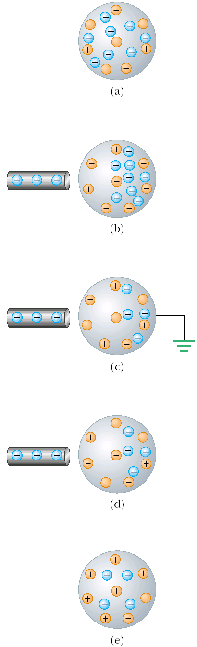
Charging by induction
We have a neutrally charged conductor.
Negatively charged rod polarizes the sphere. The charge in the rod repels electrons to the opposite side of the sphere.
Then we ground the sphere and some part of electrons is repelled into the Earth. There is induced positive charge near the rod.
Then ground connection is removed.
Eventually, we get positively charged sphere.

Slide 6
The Law of Conservation of Charge
The net charge of an isolated system is conserved.
This law is a fundamental physical law: net charge is the same before and after any interaction.

Slide 7
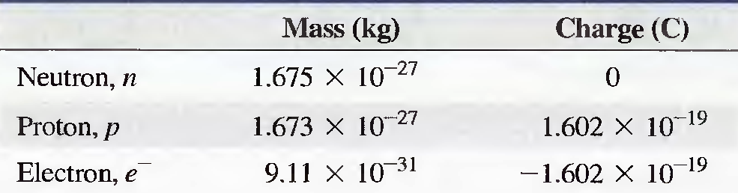
Elementary charges
Elementary charges are electrons and protons. Usually only electrons can be free and take part in electrical processes.
Excess of electrons causes negative charge and deficiency of electrons causes positive charge of a body.

Slide 8
Coulomb’s law
From Coulomb’s experiments, we can generalize the following properties of the electric force between two stationary point charges:
  is inversely proportional to the square of the separation r between the particles and directed along the line joining them;
  is proportional to the product of the charges q₁ and q₂ on the two particles;
  is attractive if the charges are of opposite sign and repulsive if the charges have the same sign;
  is a conservative force.

Slide 9
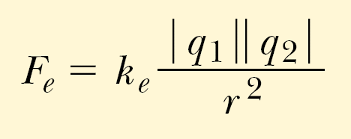

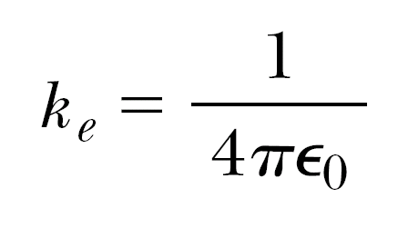
Coulomb’s Law
The magnitude of the electric force is
is the Coulomb constant, it can be written in the following form:
where is the electric permittivity of free space.

Slide 10
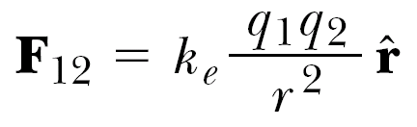

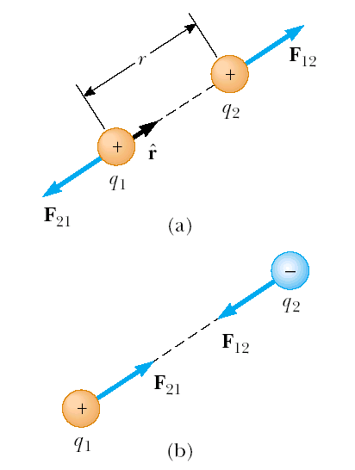
In a vector form, the force exerted by charge q₁ on q₂ is:
Where is a unit vector directed from q₁ to q_{2.}
(a) two similar charges repel
(b) two different charges attract

Slide 11
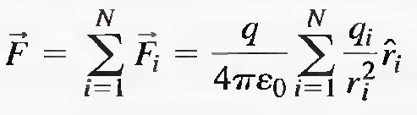
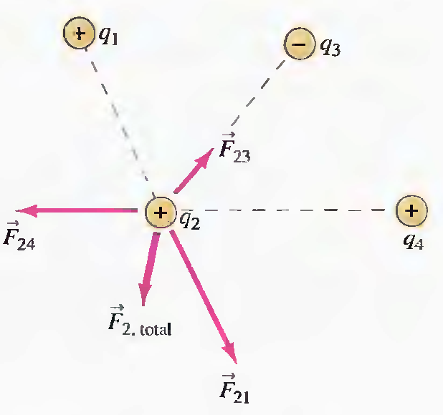

Forces of Multiple Charges
Electrostatic force is a vector quantity, so in the case of
multiple charges the principle of superposition is applicable:
The total force on charge q₂ is the vector sum of all forces:

Slide 12
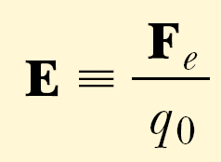
Electric Field
In general: field forces can act through space, producing an effect even when no physical contact occurs between interacting objects.
Charges gives rise to an electric field.
The electric field can be detected at any particular point by a small test positive charge q_{o} and observing if it experiences a force. Then the electric field vector is:
Note: force F_{e} and field E are not produced by the test charge q_{o} .

Slide 13
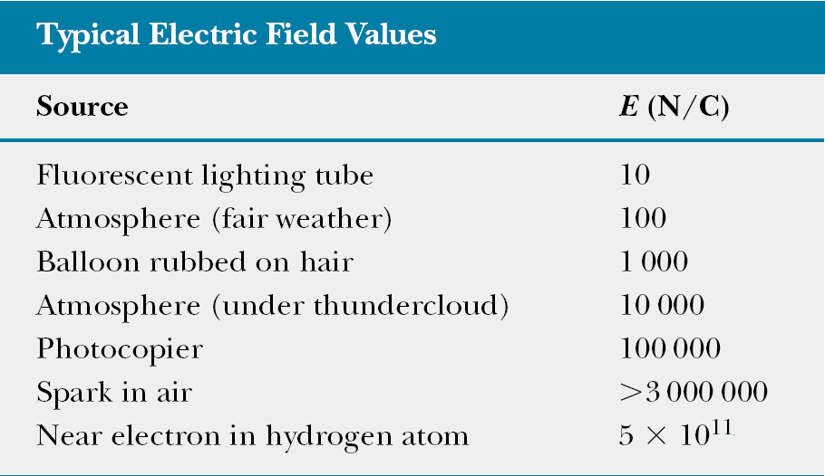

Slide 14
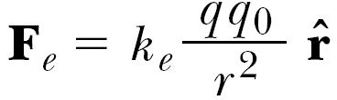
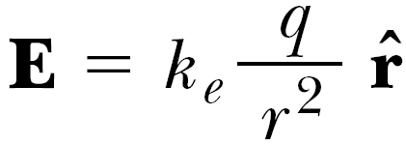
Electric Field Vector
The force exerted by q on the test charge q₀ is:
Then dividing it by q₀ we get the electric field vector:
Electric field is created by a charge.
If a charge is positive then the electric field vector is directed away from the source charge.
If a charge is negative then the electric field vector is directed to the source charge.

Slide 15
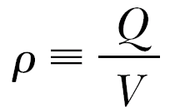

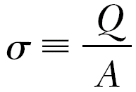

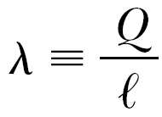

Continuous Charge Distribution
Volume charge density
Surface charge density
Linear charge density

Slide 16
Electric Field of a Uniformly Charged ring
A ring of radius a carries a uniformly distributed positive total charge Q. Let’s find the electric field due to the ring along the central axis perpendicular to the plane of the ring.

Slide 17
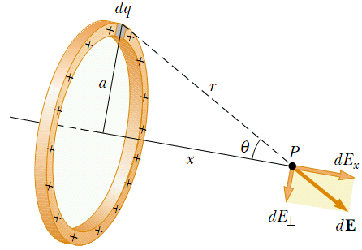
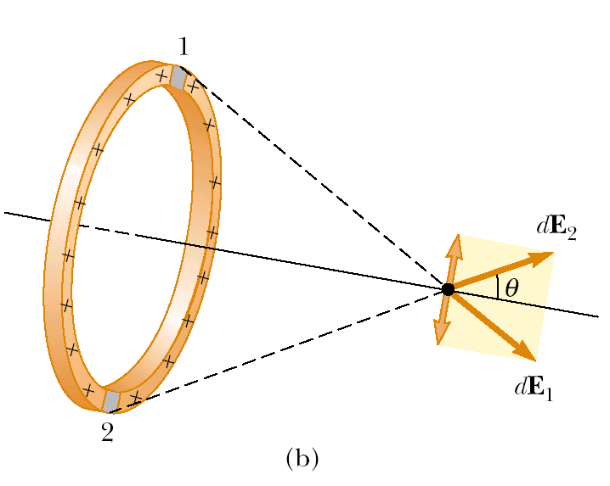
    dE is the ﬁeld at point P on the x axis due to an element of charge dq. dE has two perpendicular components:
    E_{X} and E⊥.
    Using the symmetry: The perpendicular component of the field at P due to segment 1 is canceled by the perpendicular component due to segment 2.
    Thus the total E is directed along x axis.

Slide 18


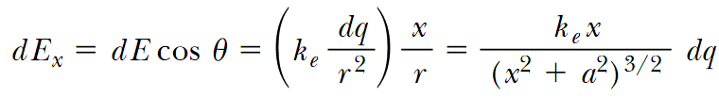
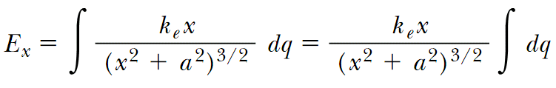
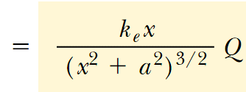
The distance from a charge dq to point P:
Then the contribution of a charge dq to electric field E at point P is:
All segments of the ring make the same contribution to the ﬁeld at P because they are all equidistant from this point. Thus, we can integrate to obtain the total ﬁeld at P:

Slide 19

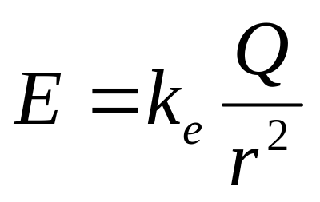
Extreme Case Analysis
So we found the electric field of a uniformly charged ring along its symmetry axis at distance x from the centre of a ring:
k_{e} is the Coulomb constant, a – the ring’s radius, Q – the charge of the ring.
Let’s analyze the obtained result for extreme cases:
If x=0, then E=0.
If x>>a, then we get the Coulomb formula for a point charge:
Look more examples of calculating electric field for continuous charge distribution:
  in Serway p.721-723,
  Fishbane 642-647.

Slide 20
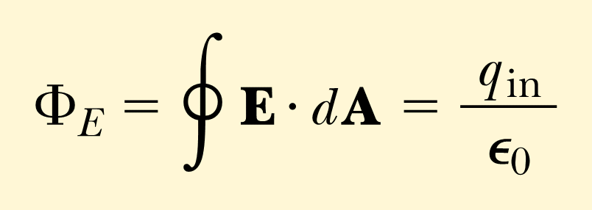
Gauss’ Law
The net flux of electric field through any enclosed surface is equal to the net charge inside that surface divided by permittivity of free space.
Here E·dA is a scalar product of electric field and differential of area vectors.

Slide 21
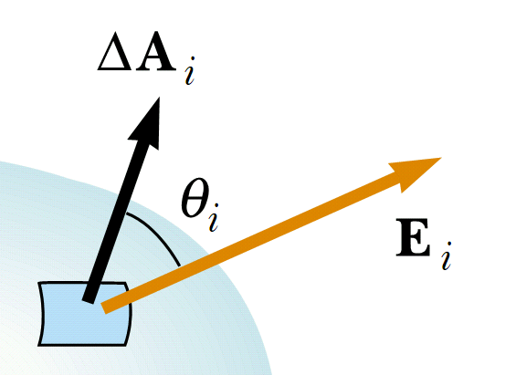

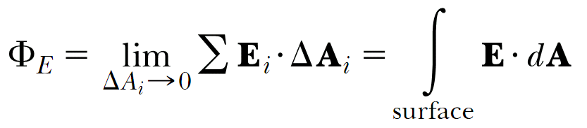
Electric Flux
ΔA_{i} is a vector, which magnitude represents the area of the i-th element of the surface and direction is deﬁned to be perpendicular to the surface element.
The variation in the electric ﬁeld over one element of surface can be neglected if the element is sufﬁciently small.
The electric ﬂux through this element is
Field lines directed into a closed surface are considered negative; those directed out of a closed surface are positive.

Slide 22
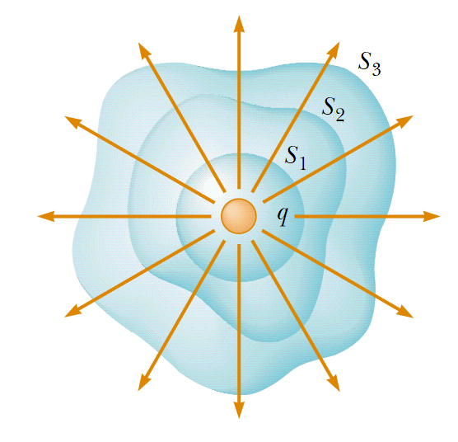
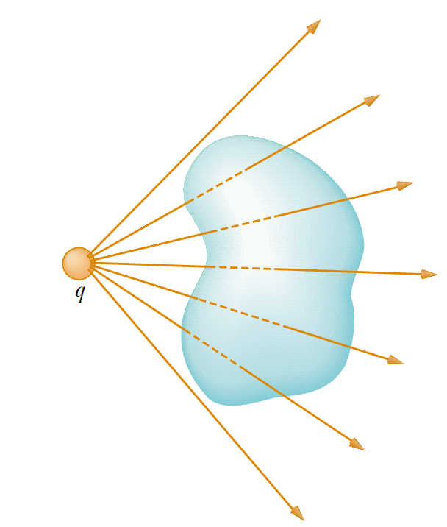
According to the Gauss’ theorem electric flux through any surface S₁, S₂, S₃ is the same.
Electric flux from a charge located outside a surface equals zero. The number of lines entering the surface equals the number leaving the surface and the net number equals zero.

Slide 23


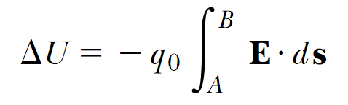
Electric Potential Energy
For infinitesimal displacement ds the work done by the electric field on the charge is .
Then the change in the potential energy of the charge-field system is
Thus for finite displacement from A to B the change in potential energy is
This line integral is not path-dependant, as the electric force is conservative.

Slide 24
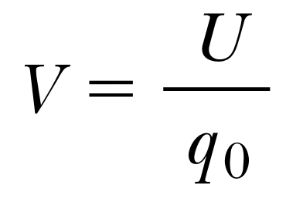
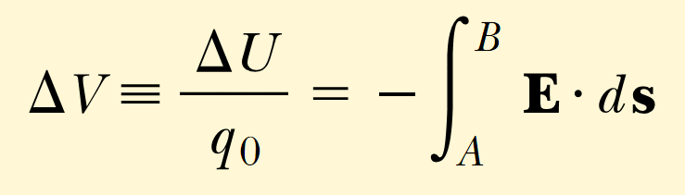
Electric Potential
The electric potential at any point in an electric field is
The potential difference ΔV=V_{B} - V_{A} between two points A and B in an electric field is defined as
q₀ is a test charge.

Slide 25
Potential Properties
Just as with potential energy, only differences in electric potential are meaningful.
Electric potential is a scalar characteristic of an electric ﬁeld, independent of any charges that may be placed in the electric field.
Electric potential energy depends on the magnitude of the charge, interacting with the field.

Slide 26
Units in SI
Charge Q C (Coulomb)
Electric potential V J/C=V (volt)
Electric field E N/C=V/m

